Slide 1

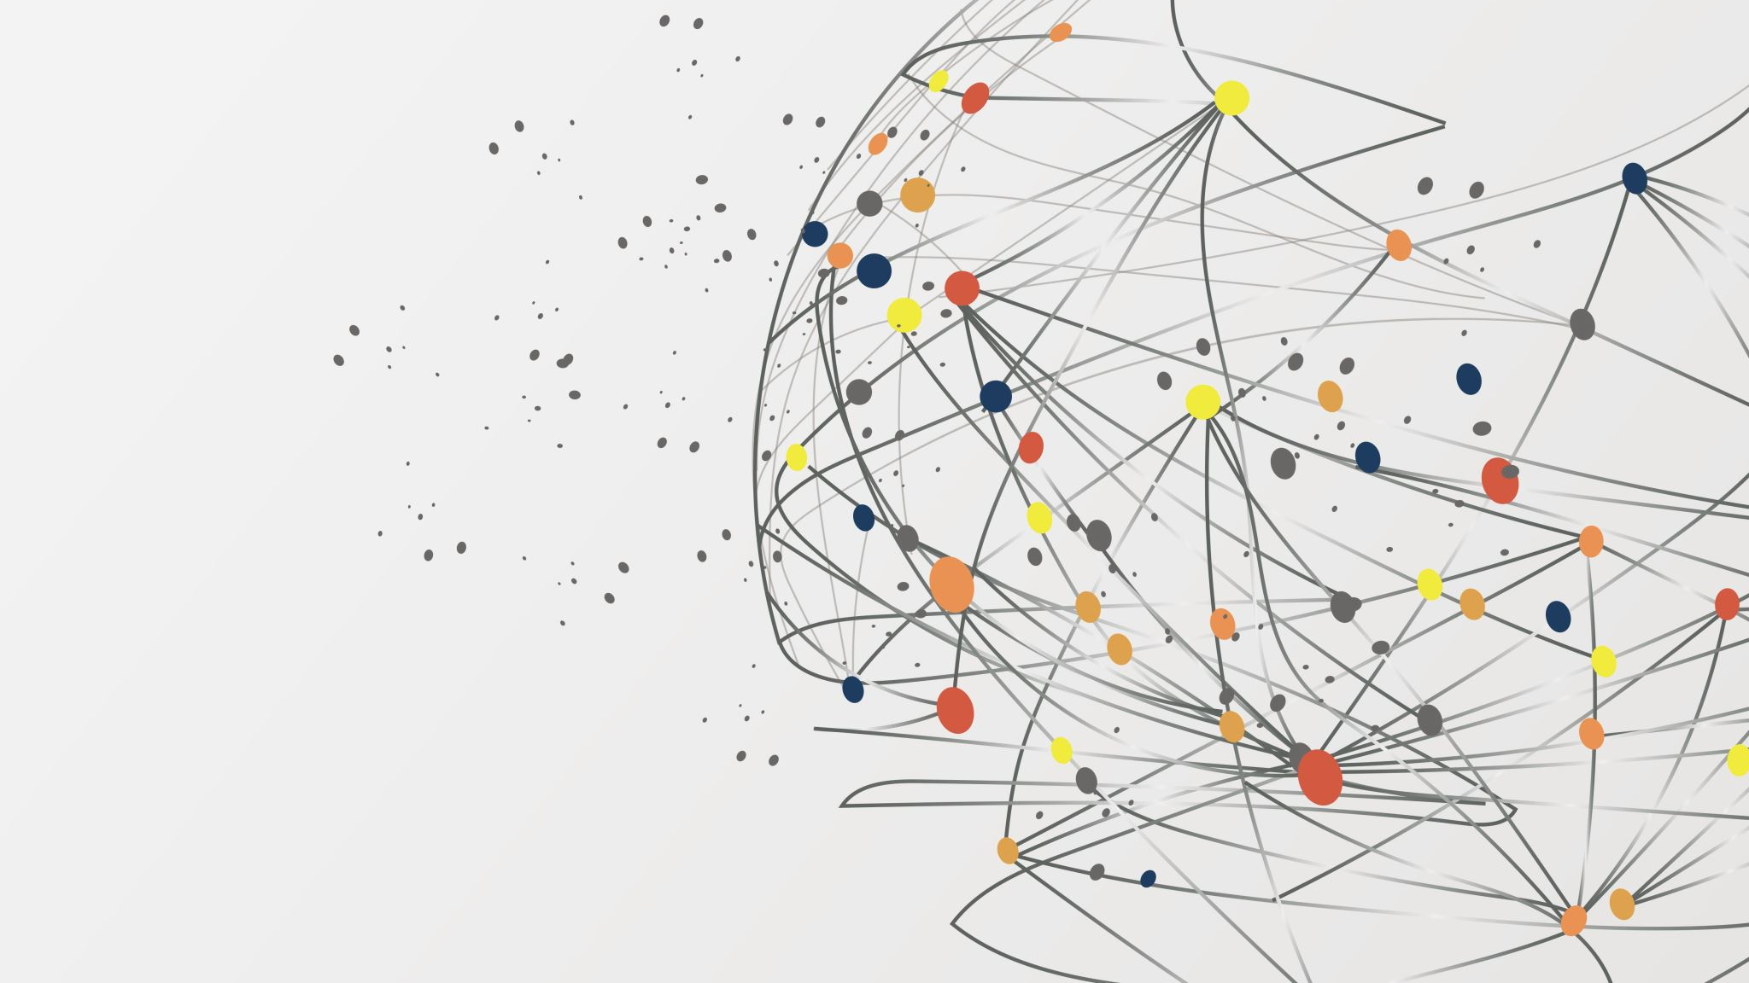
2D AI Car

Slide 2
Team
Terence Yu
Sarvang Konnur
George Nikitakis
Jaspreet Singh Marwah
Vaibhav Jain
Under the guidance of
Prof. Marcos Bittencourt

Slide 3

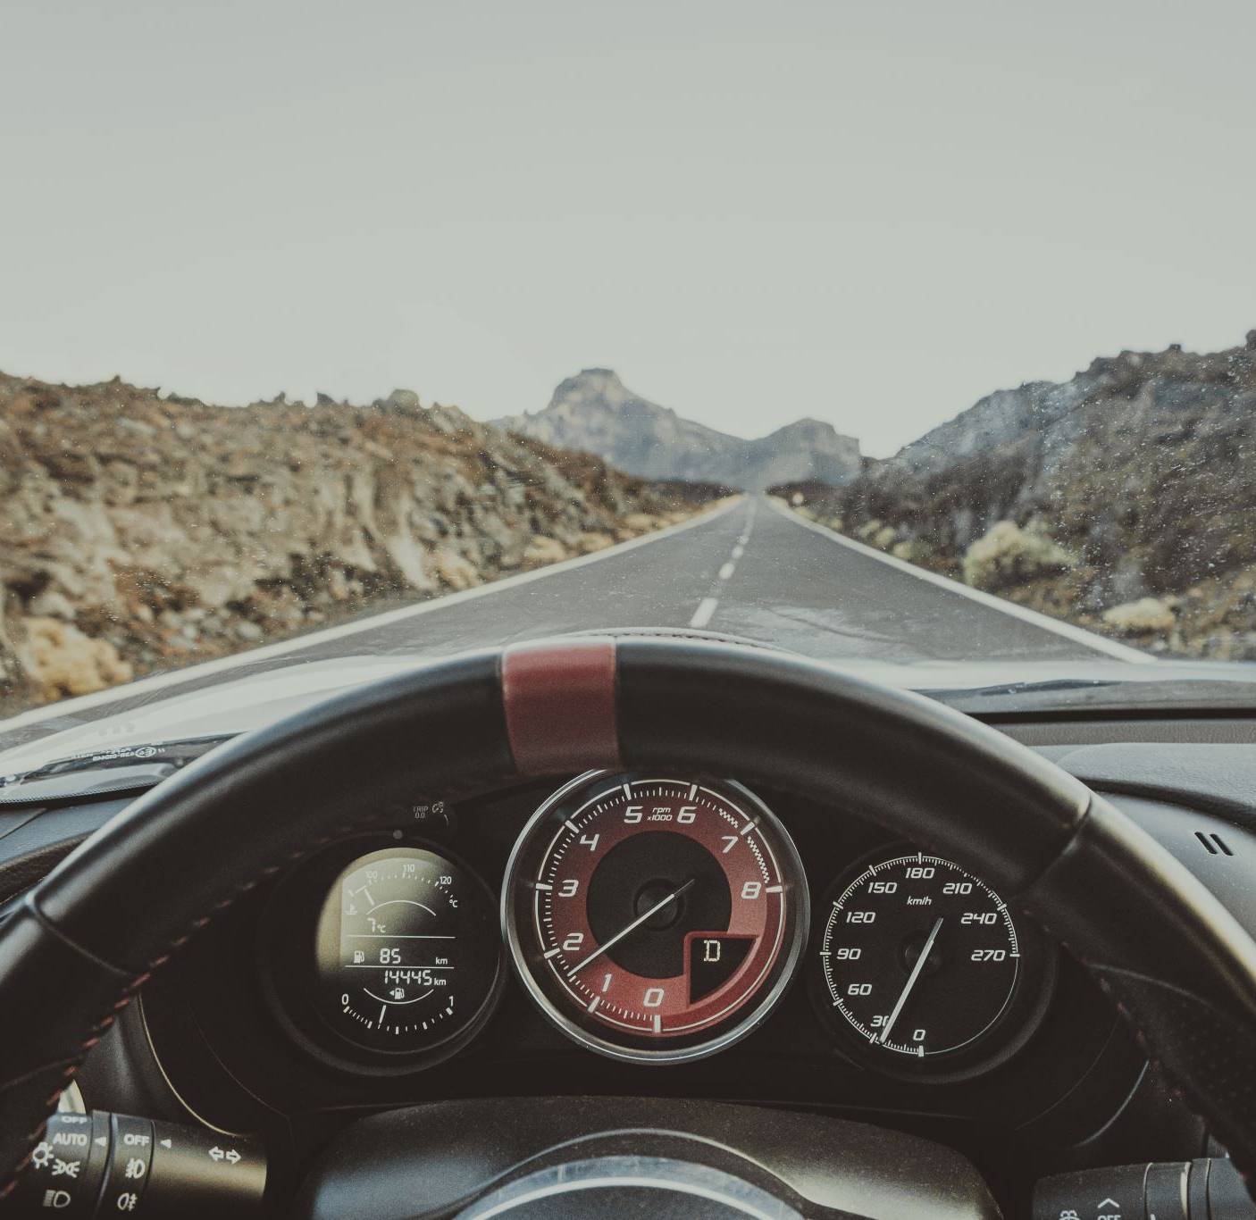
Problem Statement
Self-driving car tech is more important now than ever
Increases road safety
94% of serious crashes are due to human error [Source: NHTSA]

Slide 4
Project Description
Car racing game
The user would be able to play on the said course.
The users run would be considered as an expert and the base model would be trained first on the said run
Imitation Learning / Reinforcement Learning to improve the model performance

Slide 5
Features
2D car game (possibility of 3D scale up)
User / player can drive the car to serve as base information
Fixed paths (multiple to choose from)
User-addable obstacles

Slide 6



Approach
Task | Status
Initial Project Research
Short-list solutions for the game Engine
Short-list solutions for the AI Algorithm
Game Env Development
AI Bot Development
Initial Testing
Improvement based on test result
Final Testing
Documentation

Slide 7
Tech Stack
Language : Python
Game Environment: Piglet/Pygame
Model: Keras Sqeuential
Cloud: AWS/AZURE/HIROKU/GCP

Slide 8

Testing Parameters
Running the AI bot on a test track that it has never seen before and observing:
Count of bumps with objects or walls/track boundaries.
Car speed/Time to complete the track run/lap.
Visual verification of the track run.

Slide 9

Future Scope
Scaling up from 2D to 3D to tackle real world problems.
Increase the number of sensors for better judgement.
Adding custom paths from user's end.

Slide 10
Recommendations
Try 3d if possible
Three different obstacles: and choose from them
Different velocities
Users feedback vs bots feedback comparisons
Reach out for the Cloud framework discussion

